Slide 1
Day 4: Deployment: Front-End, Kubernetes and AWS

Slide 2

Workshop Overview for Day 1
Complete App on Local Machine Demo
10:00 - 11:30
Pavlos and Shivas
Intro to Kubernetes
11:30 - 12:00
Pavlos
AWS
Instructions/Demo
12:00-12:30
Rashmi
Sophya
12:30 - 1:30
Final Thoughts
3:00 - 4:00
Sophya
Deployment
1:30 - 3:00
Shivas and Rashmi

Slide 3
Outline
Review of Day 1-3
Local App with Front-End
Motivation for Kubernetes
Intro to Kubernetes

Slide 4
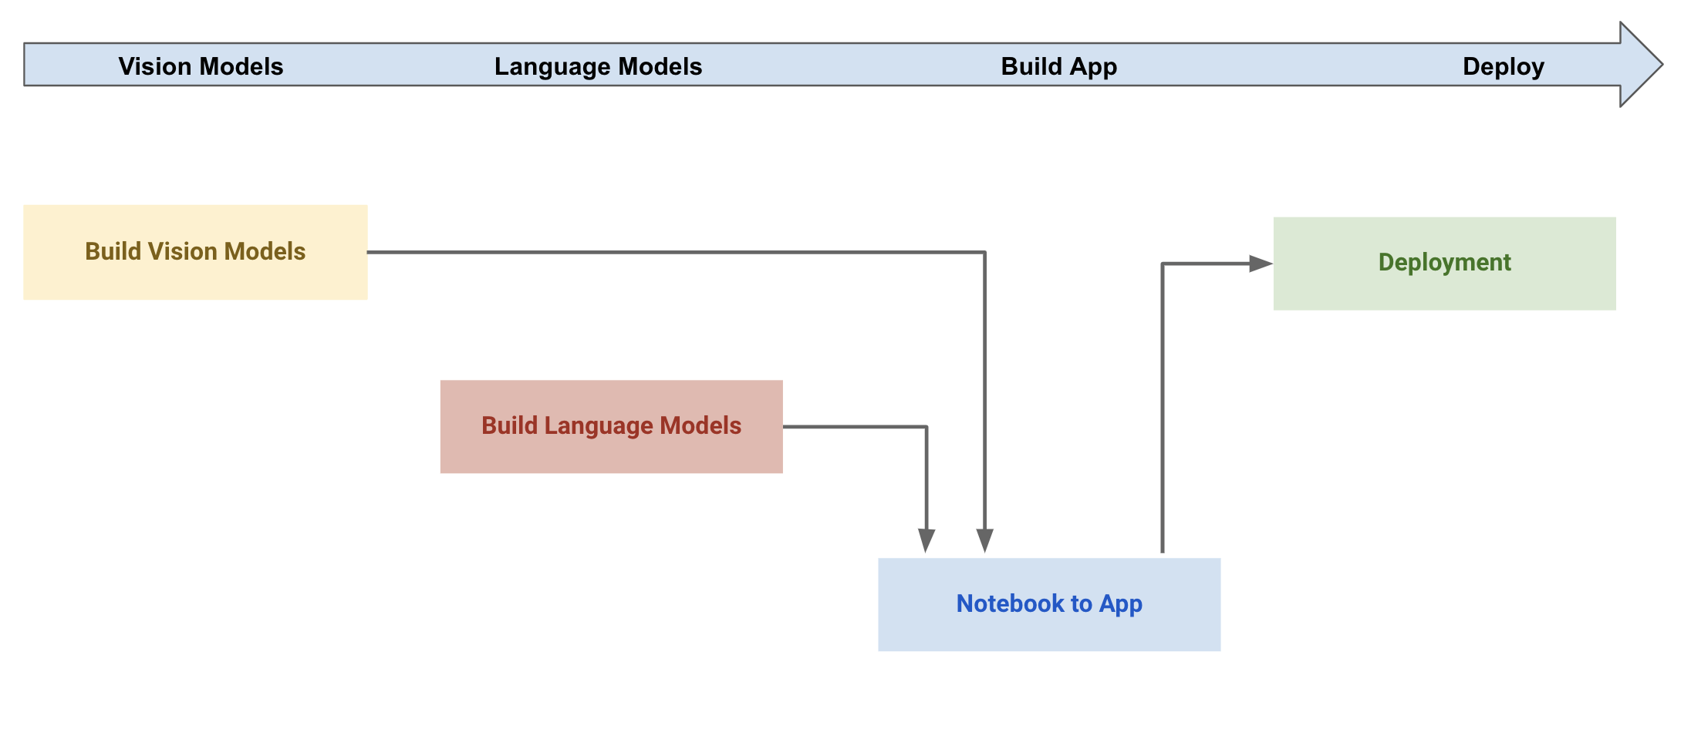
Outline

Slide 5
Virtual Environment
Pros: remove complexity
Cons: do not isolate from OS
Containers
Pros: lightweight
Cons: issues with security, scalability, and control
Virtual Machines
Pros: isolate OS guest from the host
Cons: intensive use of hardware
Monolithic
container
How to manage microservices?

Slide 6
Recap
We talked about pros/cons of
environments:
remove complexity but does not isolate from OS
virtual machines:
isolate OS guest from host but intensive use of the hardware
containers:
lightweight but issue with security, scalability, and control

Slide 7
Recap
Goal:
find effective ways to deploy our apps
break down a complex application into smaller ones (i.e. microservices)
Issues we have fixed so far:
conflicting of different operating system
different dependencies
"inexplicable" strange behavior

Slide 8
Outline
Review of Day 1-3
Local App with Front-End
Motivation for Kubernetes
Intro to Kubernetes

Slide 9
DEMO AND TUTORIAL

Slide 10
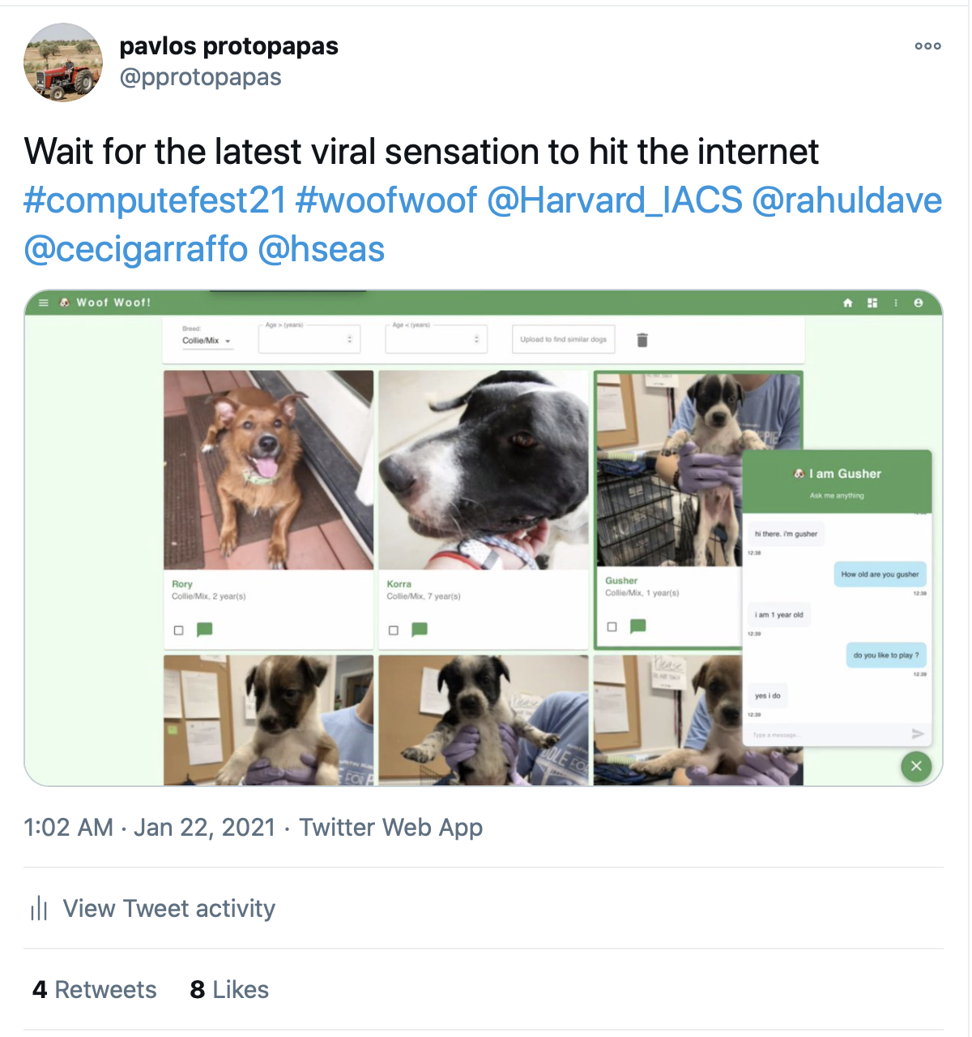

Slide 11
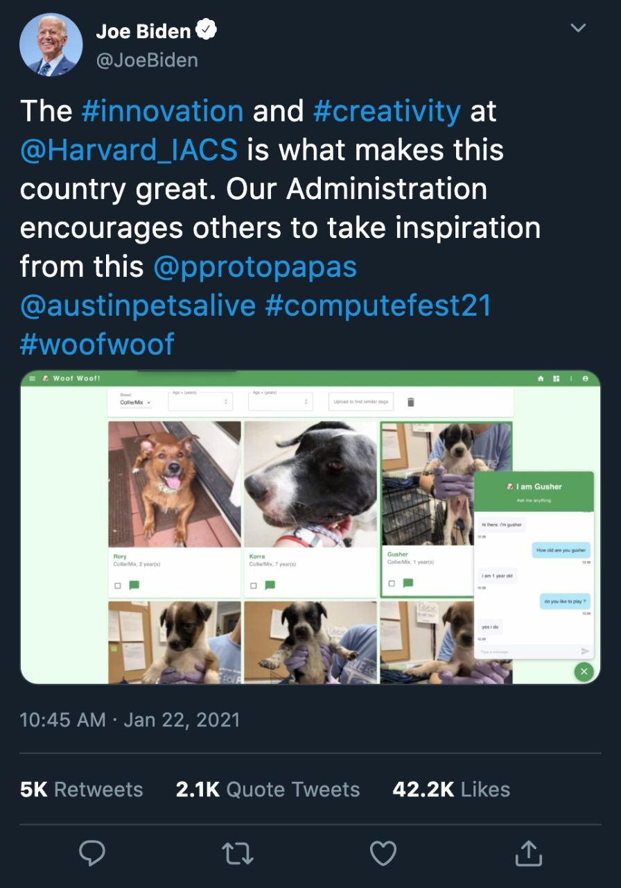

Slide 12
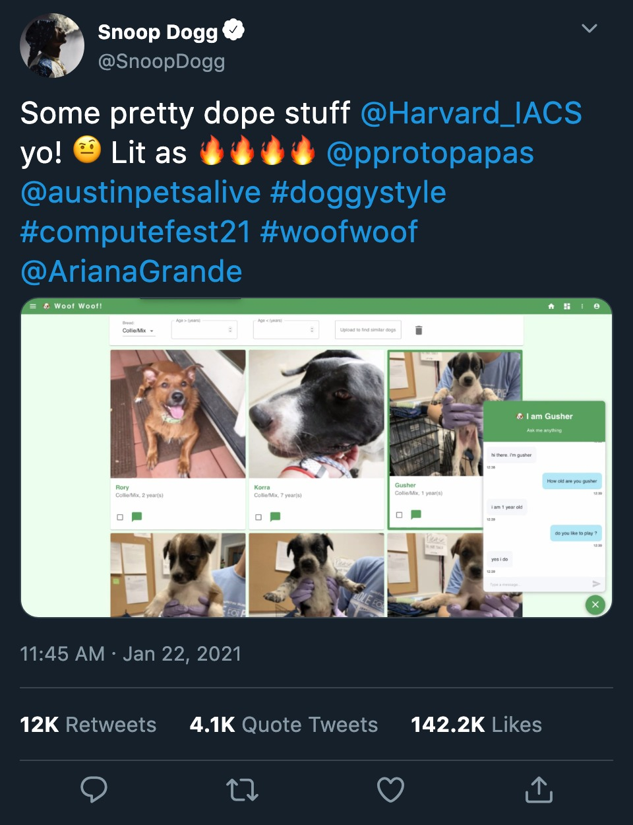

Slide 13
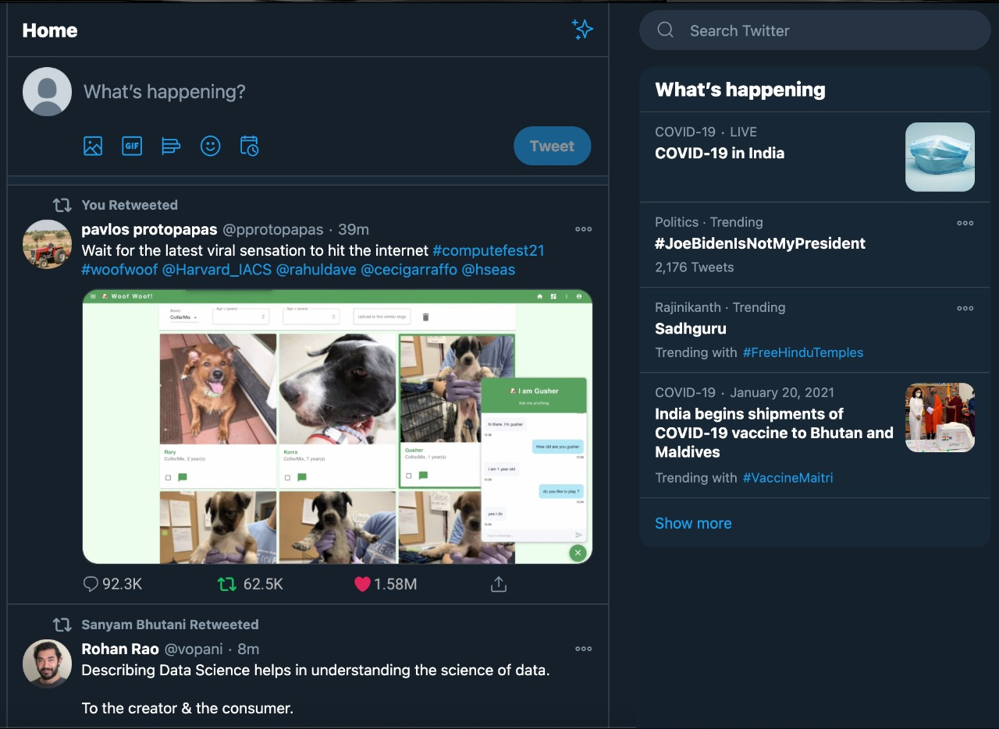

Slide 14
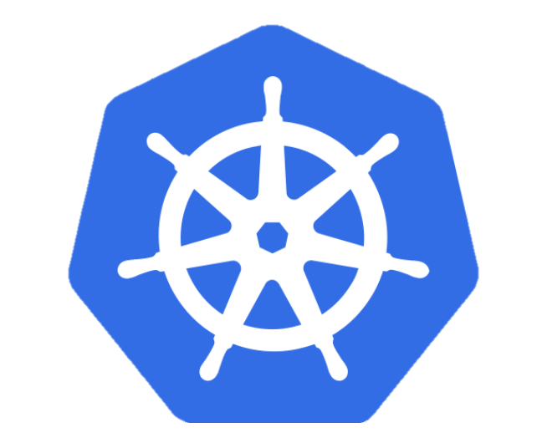
Introduction to Kubernetes <K8s>
K8s manages containers
K8s is an open-source platform for container management developed by Google and introduced in 2014. It has become the standard API for building cloud-native applications, present in nearly every public cloud.
K8s users define rules for how container management should occur, and then K8s handles the rest!
> link to website <

Slide 15
Anatomy of Kubernetes Cluster
K8s works on a cluster of machines/nodes
This could be VMs on your local machine or a group of machines through a cloud provider
The cluster includes one master node and at least one worker node

Slide 16
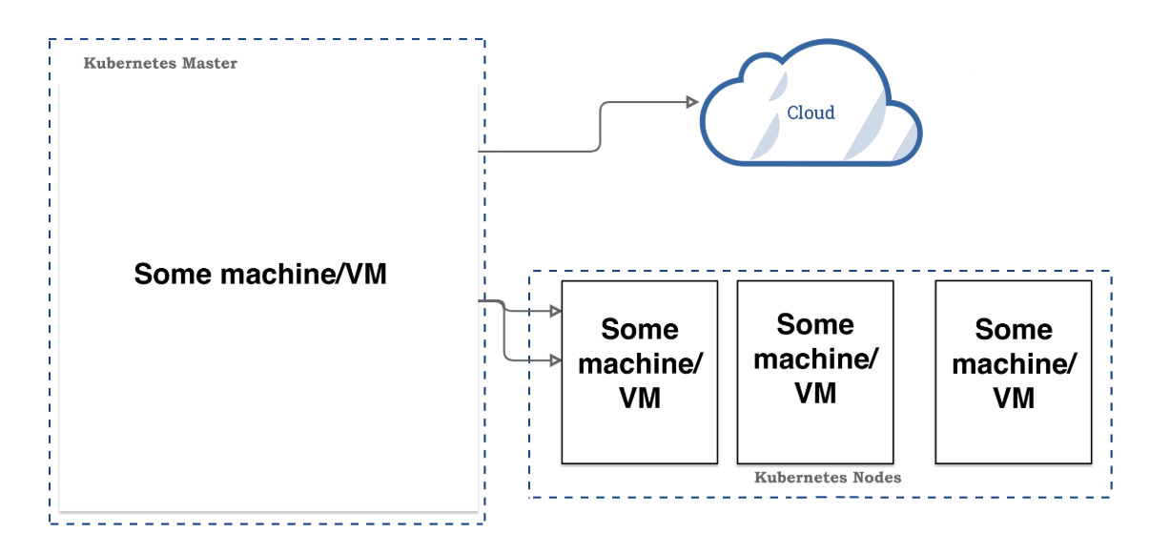
Anatomy of Kubernetes Cluster <cont>

Slide 17
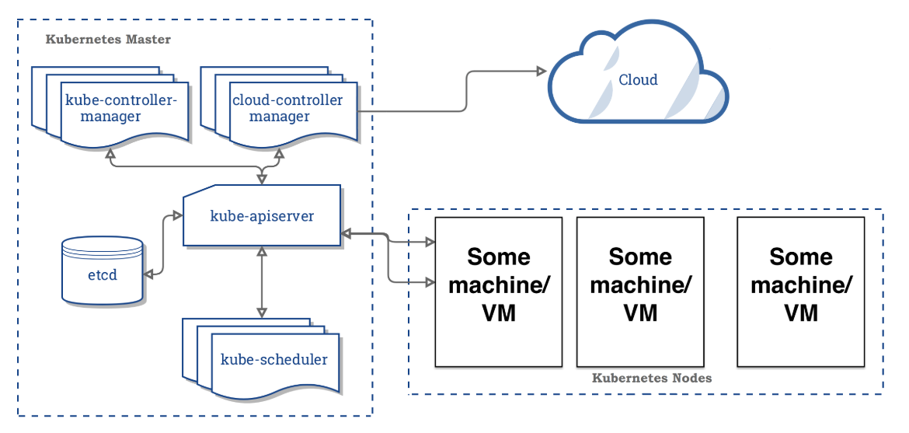
Anatomy of Kubernetes Cluster | Master Node
> to learn more on etcd <
Notes:
API server contains various methods to directly access the Kubernetes
Scheduler assigns to each worker node an application
Controller manager
3a) Keeps track of worker nodes
3b) Handles node failures and replicates if needed
3c) Provide endpoints to access the application from the outside world
4) Cloud controller communicates with cloud provide regarding resources such as nodes and IP addresses
5) Etcd works as backend for service discovery that stores the cluster’s state and its configuration

Slide 18
Anatomy of Kubernetes Cluster | Master Node
Master node main task is to manage the worker node(s) to run an application
The master node consists of:
API server contains various methods to directly access the Kubernetes
Scheduler assigns to each worker node an application
Controller manager
3a) Keeps track of worker nodes
3b) Handles node failures and replicates if needed
3c) Provide endpoints to access the application from the outside world
4) Cloud controller communicates with cloud provide regarding resources such as nodes and IP addresses
5) Etcd works as backend for service discovery that stores the cluster’s state and its configuration

Slide 19
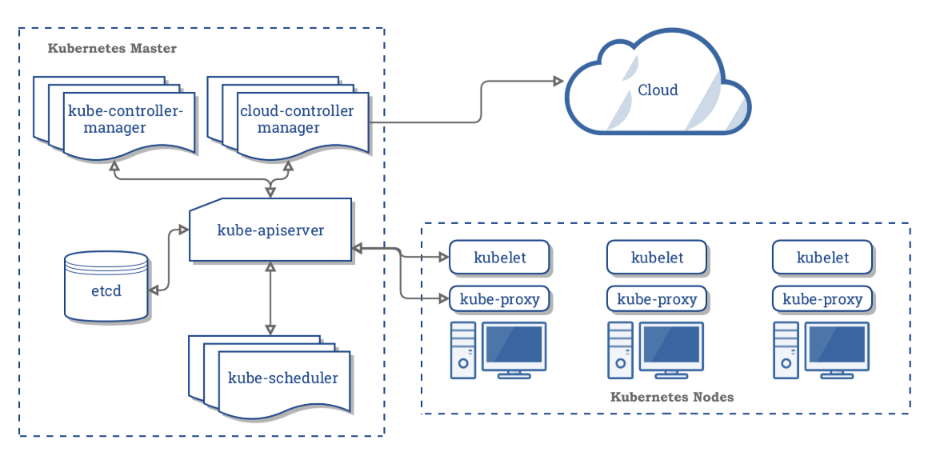
Anatomy of Kubernetes Cluster | Worker Nodes

Slide 20
Anatomy of Kubernetes Cluster | Worker Nodes
A worker node consists of:
Container runtime that pulls a specified Docker image and deploys it on a worker node
2) Kubelet talks to the API server and manages containers on its node
3) Kube-proxy load-balances network traffic between application components and the outside world
Notes:
A worker node consists of:
Container runtime that pulls a specified Docker image and deploys it on a worker node
2) Kubelet talks to the API server and manages containers on its node
3) Kube-proxy load-balances network traffic between application components and the outside world

Slide 21
Common kubectl Commands
Useful commands to complete the exercise:
$ kubectl create -f app-db-deploymnet.yaml
$ kubectl get deployment
$ kubectl get pods
$ kubectl get pods /
-o=custom-columns=NAME:.metadata.name,IP:.status.podIP
$ kubectl create -f app-server-deploymnet.yaml
$ kubectl expose deployment /
app-deployment --type=LoadBalancer --port=8080
$ kubectl get services
$ kubectl delete service app-deployment
$ kubectl delete deployment app-server-deployment
$ kubectl delete deployment app-db-deployment

Slide 22
Common kubectl Commands
Practice Kubernetes! Access the exercise using the link below:
> LINK TO EXERCISE <
> LINK TO RESOURCES <

Slide 23
Workshop Overview for Day 1
Complete App on Local Machine Demo
10:00 - 11:30
Pavlos Shivas
Intro to Kubernetes
11:30 - 12:00
Pavlos
AWS
Instructions/Demo
12:00-12:30
Rashmi
Sophya
12:30 - 1:30
Final Thoughts
3:00 - 4:00
Sophya
Deployment
1:30 – 3:00
Shivas Rashmi

